Slide 1

hope foundation finolex academy of management and technology department of information technology EMAIL MONITORING SYSTEM
Presented By –
Mhadgut Asavari Pradeepkumar - 36
Nalawade Sayali Umesh - 46
Ranshur Pratiksha Dilip - 64
Guided By –
Prof. Atiya Kazi

Slide 2
CONTENTS
Problem Statement
Literature Review
Existing System
Proposed System
System Architecture
Flowchart
Algorithms
System Requirement
Conclusion

Slide 3
PROBLEM STATEMENT
Email Spam has become a major problem nowadays , with rapid growth of internet users . Spam email are the messages sent to multiple addresses . People are using them for illegal and unethical conducts such as phishing and frauds .
So it is needed to identify those spam mails which are fraud .
Using Email Monitoring System , spam and non-spam emails are classified using ML algorithm like Naïve Bayes and KNN and Logistic Regression .

Slide 4
LITERATURE REVIEW
Paper | Features
Email based spam detection | In this spam classification is created using Bayes theorem and Naïve Bayes classifier and also IP addresses of the sender are often detected. And its accuracy is 97% .
Spam email using Naïve Bayes Classifier | In this, it creates spam Email classification using Naïve Bayes Algorithm and the accuracy is 99%. Also calculates error rate.
Existing Email Spam Filtering Method | In this the system Uses Machine Learning techniques like Naïve Bayes, KNN, SVM and summarizes overall scenario regarding Accuracy Rate.
Email spam filtering using ML | It compares implemented algorithm of XGboosting Classifier with existed classifier of SVM, Naïve Bayes and its accuracy is 95%
Machine Learning Techniques for spam Email | It implements spam detection by using Machine learning and deep Learning Techniques like Naïve Bayes, Decision Tree, Neural Networks and Random forest.

Slide 5
EXISTING SYSTEM
The Existing Email system has a weak spam detection Mechanism.
This results in segregation of important emails into spam emails.
This can lead to misscommunication or delay of messages.
Sometimes some unimportant or phishing emails are not segregated into spam folder which leads unnecessary attention to unimportant emails .

Slide 6
PROPOSED SYSTEM
In this system to solve the problem of spam , email monitoring system is implemented using machine learning algorithms like Naive Bayes and KNN and accuracy of both these algorithms is compared .
Using this system the problem of existing system is been solved.

Slide 7
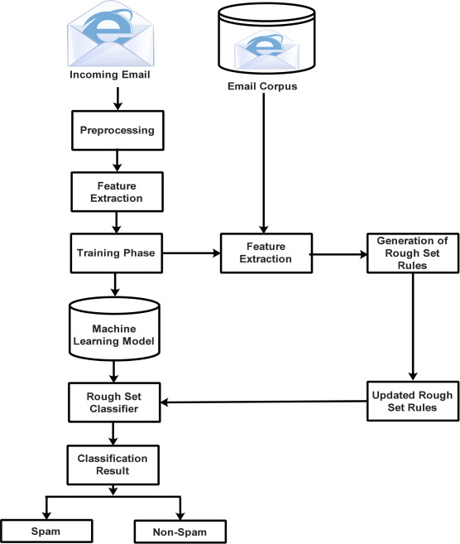
SYSTEM ARCHITECTURE
Naïve Bayes / KNN
Data Set: spambase.csb

Slide 8
FLOWCHART
Dataset
Collection of data
Pre-processing and filtering of data
Classification of email data
Spam/Non-Spam
Analyze the performance parameters

Slide 9
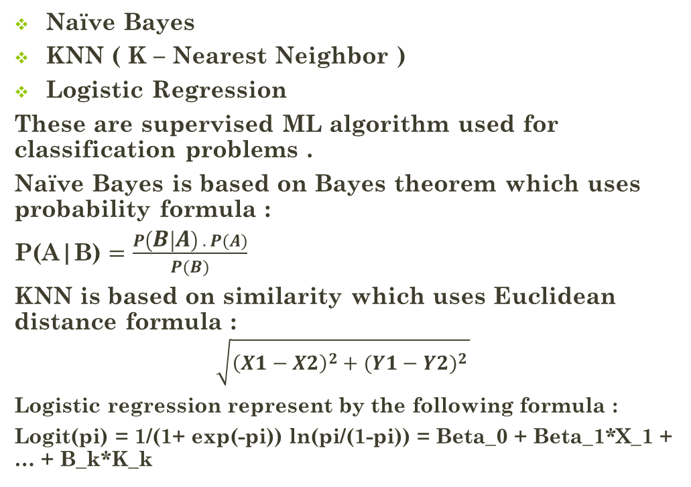
ALGORITHMS
Naïve Bayes
KNN ( K – Nearest Neighbor )
Logistic Regression
These are supervised ML algorithm used for classification problems .
Naïve Bayes is based on Bayes theorem which uses probability formula :
P(A|B) $=\frac{P\left(B | A\right) . P(A)}{P(B)}$
KNN is based on similarity which uses Euclidean distance formula :
$$\sqrt{{\left(X1−X2\right)}^{2}+{(Y1−Y2)}^{2 }}$$
Logistic regression represent by the following formula :
Logit(pi) = 1/(1+ exp(-pi)) ln(pi/(1-pi)) = Beta_0 + Beta_1*X_1 + … + B_k*K_k

Slide 10
SYSTEM REQUIREMENT
HARDWARE REQUIREMENTS :
Operating system : Windows
RAM : 8 GB( minimum requirement )
Hard Disk : 1GB working space (minimum requirement)
SOFTWARE REQUIREMENT:
Languages : Python
Tools : Google Colab / PyCharm, VS code , Flask

Slide 11
CONCLUSION
We will implement email monitoring system using Machine Learning Algorithms such as Naive Bayes Algorithm and KNN ( K-Nearest Neighbor ) and Linear Regression Algorithm and compare which is better .

Slide 12
THANK YOU

